Slide 1
Learn Redis
What is Redis?

Slide 2
What Is Redis?
Redis is an open source, in-memory data structure store, used as database, cache and message broker
NoSQL Key/Value Store

Slide 3
Is it Like MongoDB?
Redis is similar to MongoDB in that it is NoSQL and could be used for similar key/value cases
MongoDB is a “disk-based” document store while Redis is “memory-based”
Redis is used for caching

Slide 4
Is It Like Memcached?
It is similar to Memcached in that the data is stored in memory
Memcached uses volatile cache, therefore the data does not get persisted and is lost with a restart. Redis uses built-in persistence and will not disappear with a restart

Slide 5
More DataTypes
The datatypes that Redis allows is one of it’s best features
Strings
Hashes
Lists
Sets
Sorted Sets
Bitmaps
Hyperlogs
Geospatial Indexes

Slide 6
Scaling & Partitioning
Not the easiest thing to do
Has gotten better
Depends on using Redis as cache or data store
Partitioning: Spit data among multiple Redis instances

Slide 7
General Security Model
Designed to be accessed by trusted clients inside trusted environments
Not usually a good idea to expose Redis directly
Clients inside front-end of a web application will query Redis
Not optimized for max security but for max performance

Slide 8
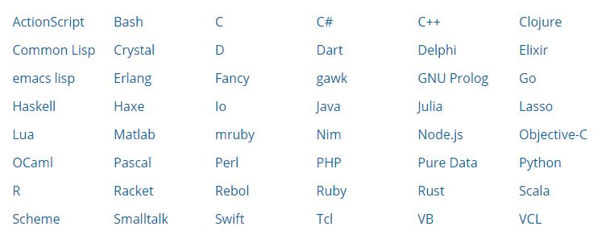
Redis Clients
Redis has clients for just about every popular programming language
http://redis.io/clients

Slide 9


